Slide 1



Hospitality Revenue Analysis
View in Power BI
Last data refresh:
4/5/2023 9:26:34 AM UTC
Downloaded at:
4/9/2023 3:59:45 PM UTC

Slide 2
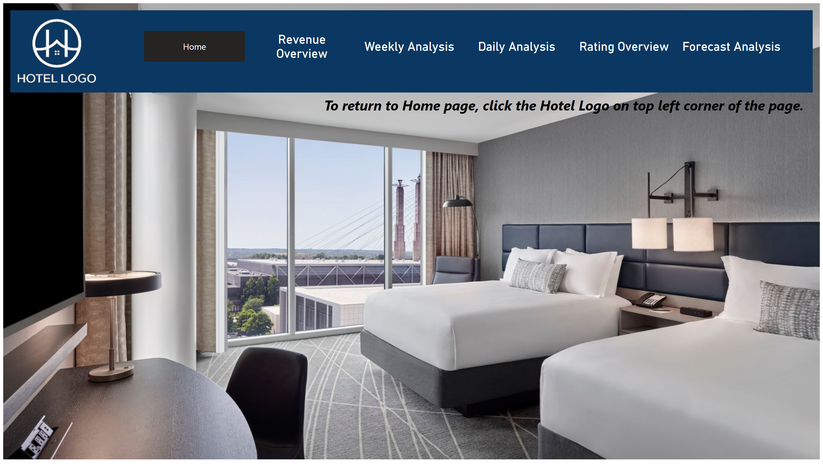
Home
Notes:
shape
No alt text provided
image
No alt text provided
pageNavigator
No alt text provided
image
No alt text provided
textbox
No alt text provided

Slide 3
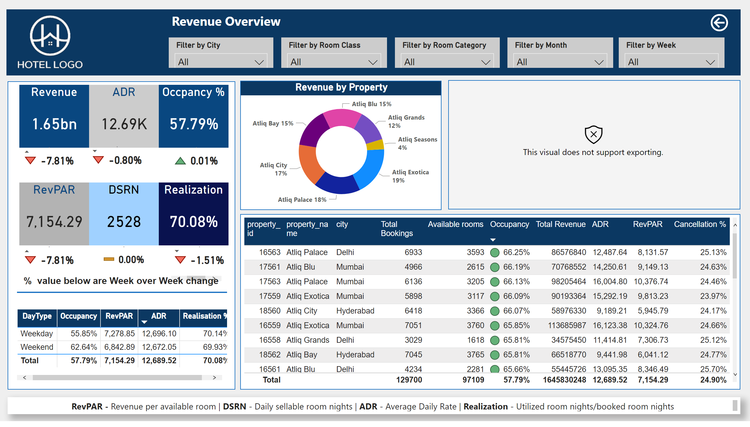
Revenue Overview
Notes:
Revenue
No alt text provided
ADR
No alt text provided
Occpancy %
No alt text provided
tableEx
No alt text provided
tableEx
No alt text provided
tableEx
No alt text provided
Realization
No alt text provided
DSRN
No alt text provided
RevPAR
No alt text provided
tableEx
No alt text provided
tableEx
No alt text provided
tableEx
No alt text provided
tableEx
No alt text provided
shape
No alt text provided
textbox
No alt text provided
shape
No alt text provided
image
No alt text provided
textbox
No alt text provided
slicer
No alt text provided
slicer
No alt text provided
slicer
No alt text provided
slicer
No alt text provided
slicer
No alt text provided
Revenue by Property
No alt text provided
Revenue by Property
No alt text provided
textbox
No alt text provided
Occupancy by city (Hover mouse over bubble to see details)
No alt text provided
actionButton
No alt text provided
shape
No alt text provided

Slide 4
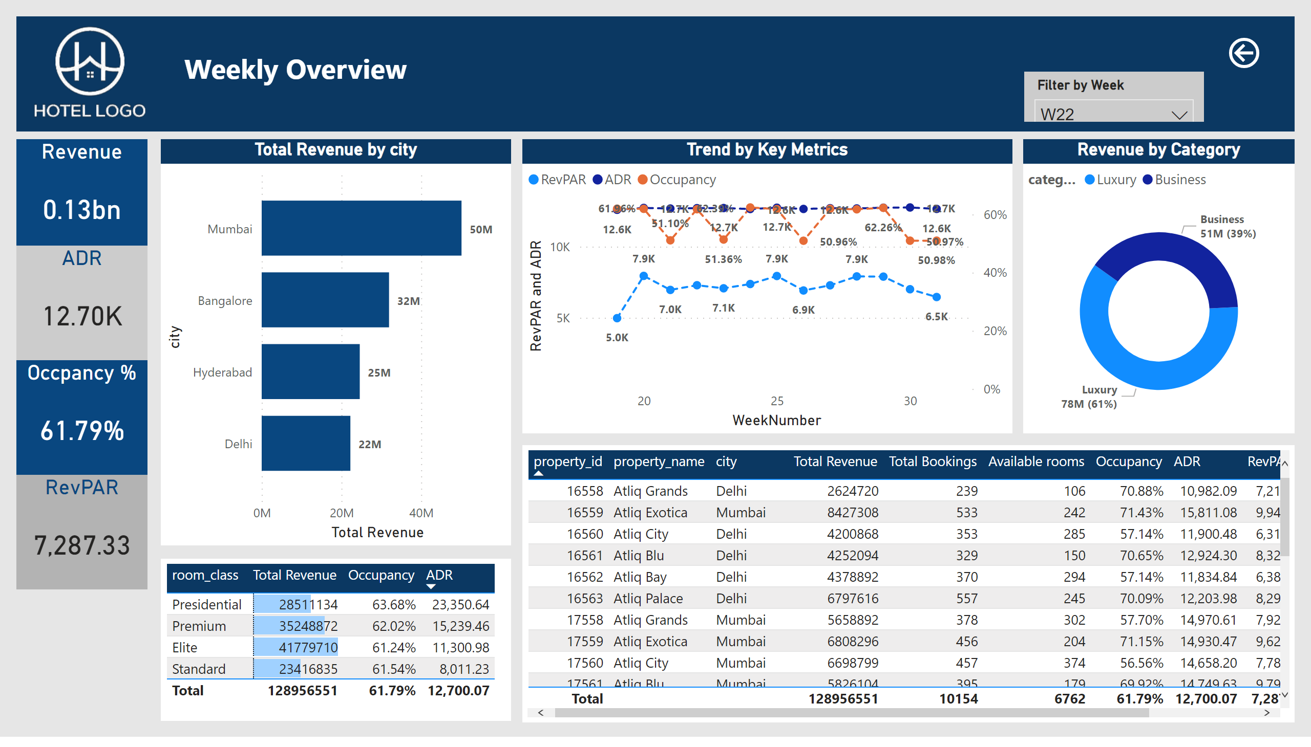
Weekly Analysis
Notes:
clusteredBarChart
No alt text provided
Revenue by Property
No alt text provided
tableEx
No alt text provided
shape
No alt text provided
textbox
No alt text provided
image
No alt text provided
slicer
No alt text provided
textbox
No alt text provided
actionButton
No alt text provided
slicer
No alt text provided
Revenue
No alt text provided
ADR
No alt text provided
Occpancy %
No alt text provided
RevPAR
No alt text provided
Revenue by Category
No alt text provided
Trend by Key Metrics
No alt text provided

Slide 5
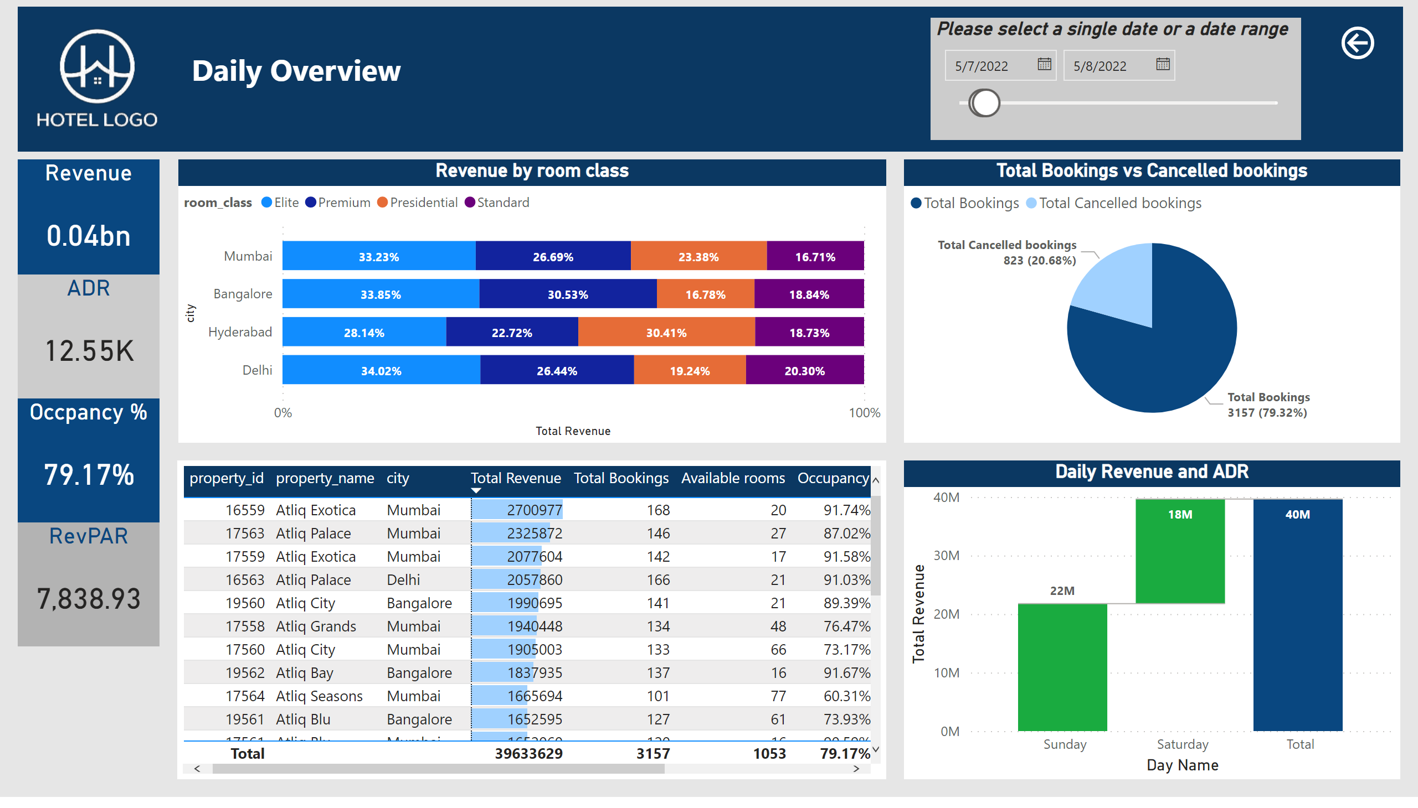
Daily Analysis
Notes:
Revenue by room class
No alt text provided
Revenue by Property
No alt text provided
shape
No alt text provided
textbox
No alt text provided
image
No alt text provided
Please select a single date or a date range
No alt text provided
actionButton
No alt text provided
Revenue
No alt text provided
ADR
No alt text provided
Occpancy %
No alt text provided
RevPAR
No alt text provided
Total Bookings vs Cancelled bookings
No alt text provided
Daily Revenue and ADR
No alt text provided

Slide 6
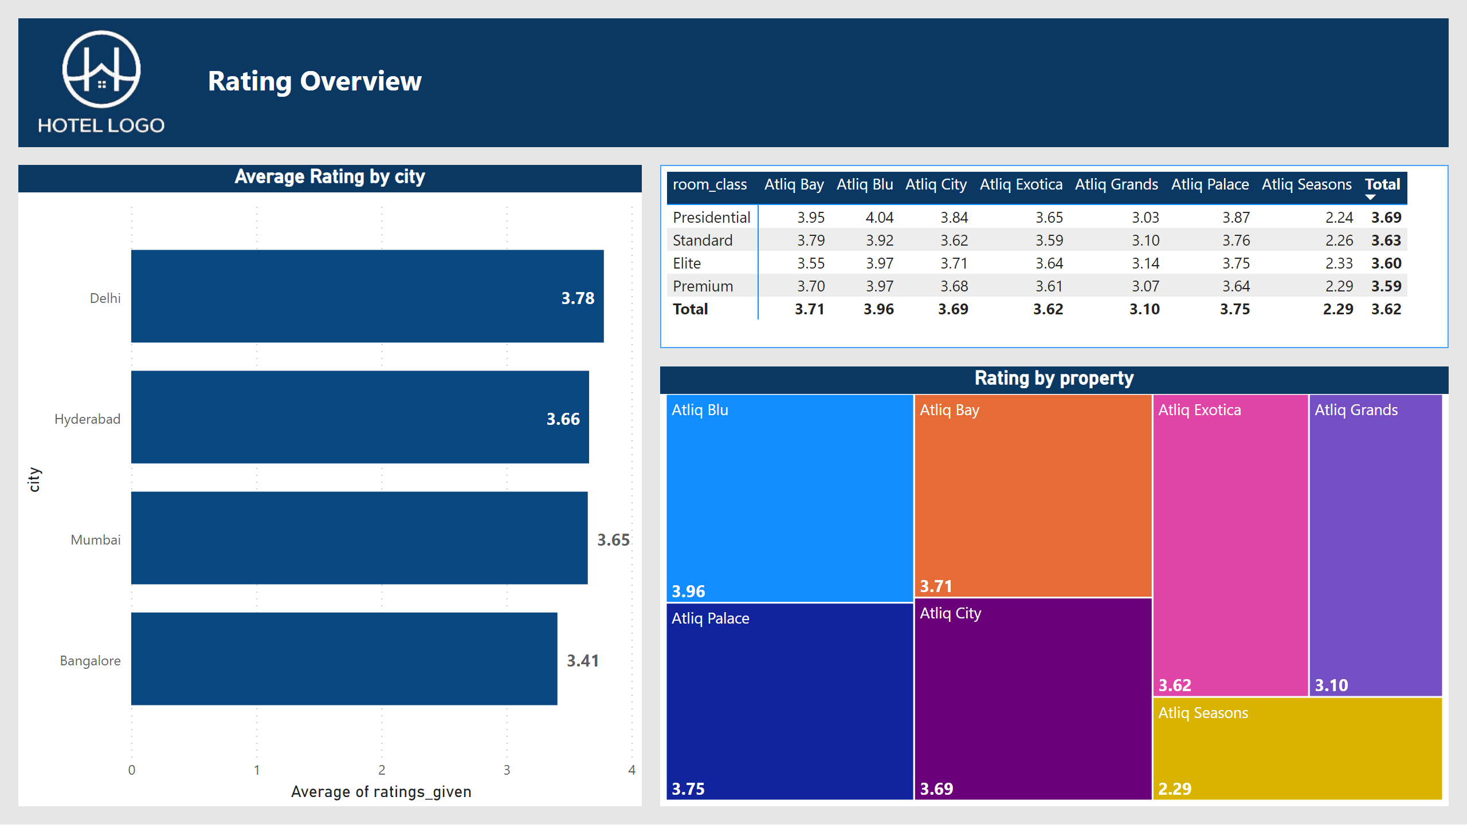
Rating Overview
Notes:
image
No alt text provided
Average Rating by city
No alt text provided
textbox
No alt text provided
Average Rating by room class
No alt text provided
textbox
No alt text provided
shape
No alt text provided
Rating by property
No alt text provided

Slide 7
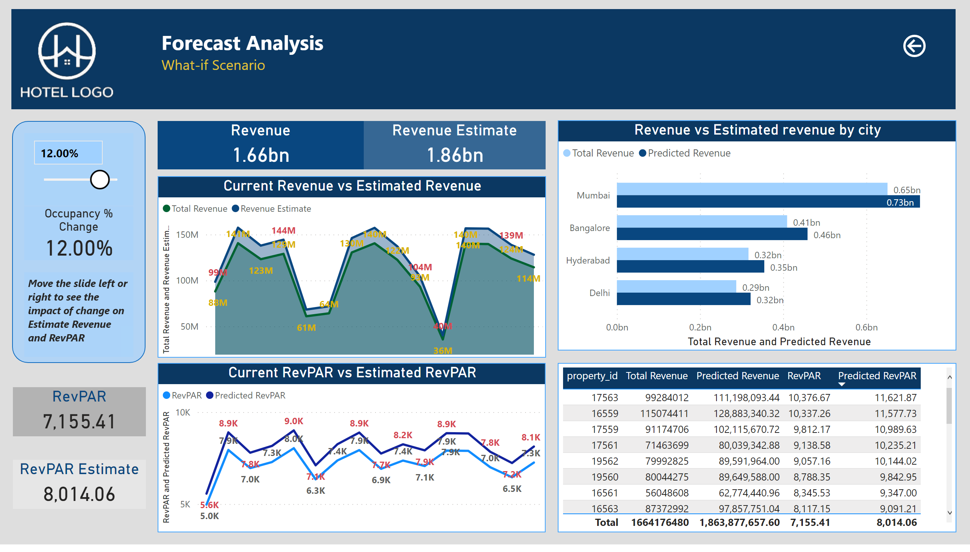
Forecast Analysis
Notes:
slicer
No alt text provided
Occupancy % Change
No alt text provided
shape
No alt text provided
image
No alt text provided
Current Revenue vs Estimated Revenue
No alt text provided
Revenue Estimate
No alt text provided
Revenue
No alt text provided
RevPAR
No alt text provided
Current RevPAR vs Estimated RevPAR
No alt text provided
RevPAR Estimate
No alt text provided
shape
No alt text provided
textbox
No alt text provided
tableEx
No alt text provided
textbox
No alt text provided
actionButton
No alt text provided
Revenue vs Estimated revenue by city
No alt text provided

Slide 8
Some Important insights
Mumbai generates the highest revenue (784M) followed by Bangalore,Hyderabad,Delhi.
Atliq Exotica performs better compared to all 7 type of properties with 374M revenue,60% occupancy rate,rating 3.62 and 24.37% cancellation rate.
Atliq Blu has the highest occupancy rate.
Delhi tops in rating and occupancy followed by Hyderabad,Mumbai and Bangalore.
Atliq lost around 298.7 Million revenue due to cancellation.
Week 24 recorded the highest revenue of 164.6 Million revenue.
Elite type rooms have the most booking followed by standard type.
We need to focus more on Elite customers across the cities as they drive the revenue boost. RT2 Room type should be prioritized more as it has the highest influence on revenue.
We should make a good connection with the make your trip and log trip platforms. The last two weekends should be in focus to create a balance in realized revenue.

